Slide 1
Algorithms
Lecture 1
Time Complexity & Asymptotic Analysis
Department of Computer Science and Engineering
BRAC University

Slide 2
Algorithm Definition
A finite set of statements that guarantees an optimal solution in finite interval of time
Algorithmic thinking and problem solving skill are vital in making efficient solutions.
The English word "ALGORITHM" derives from the Latin word AL- AL-KHWARIZMI’S name. He developed the concept of an algorithm in Mathematics, and thus sometimes being called the “Grandfather of Computer Science".

Slide 3
Glance of Algorithm
An algorithm is a finite set of instructions or logic, written in order, to accomplish a certain predefined task.
Algorithm is not the complete code or program
Can be expressed either as an informal high level description as pseudocode or using a flowchart.

Slide 4
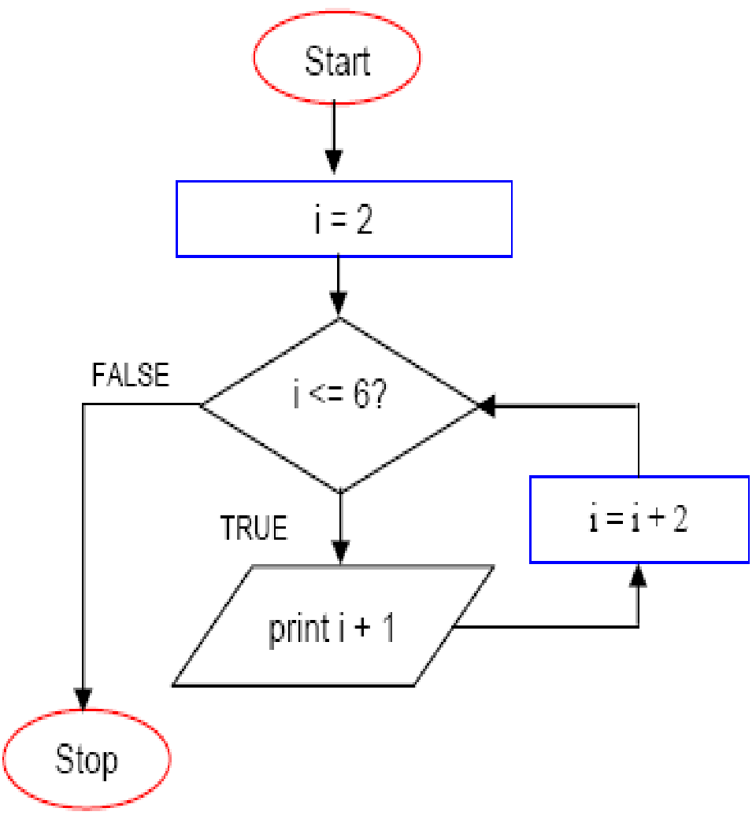
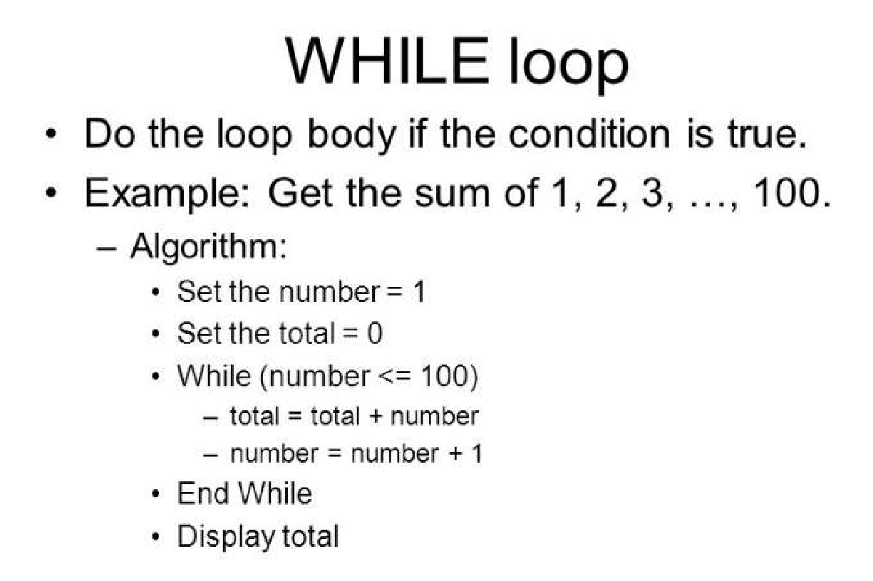
Glance of Algorithm

Slide 5
Algorithm Specifications
Input - Every Algorithm must take zero or more number of input values from external.
Output - Every Algorithm must produce an output as result.
Definiteness - Every statement/instruction in an algorithm must be clear and unambiguous (only one interpretation)
Finiteness - For all different cases, the algorithm must produce result within a finite number of steps.
Effectiveness - Every Instruction must be basic enough to be carried out and it also must be feasible.

Slide 6
Good Algorithms?
Run in less time
Consume less memory
But computational resources (time complexity) usually important

Slide 7
Analyzing Algorithms
Predict the amount of resources required:
memory: how much space is needed?
computational time: how fast the algorithm runs?
FACT: running time grows with the size of the input
Input size (number of elements in the input)
Size of an array, polynomial degree, # of elements in a matrix, # of bits in the binary representation of the input, vertices and edges in a graph
Def: Running time = the number of primitive operations (steps) executed before termination
Arithmetic operations (+, -, *), data movement, control, decision making (if, while), comparison

Slide 8
Algorithm Analysis: Example
Alg.: MIN (a[1], …, a[n])
m ← a[1];
for i ← 2 to n
if a[i] < m
then m ← a[i];
Running time:
the number of primitive operations (steps) executed before termination
T(n) =1 [first step] + (n) [for loop] + (n-1) [if condition] + (n-1) [the assignment in then] = 3n - 1
Order (rate) of growth:
The leading term of the formula
Expresses the asymptotic behavior of the algorithm

Slide 9
Typical Running Time Functions
1 (constant running time):
Instructions are executed once or a few times
logN (logarithmic)
A big problem is solved by cutting the original problem in smaller sizes, by a constant fraction at each step
N (linear)
A small amount of processing is done on each input element
N logN
A problem is solved by dividing it into smaller problems, solving them independently and combining the solution

Slide 10
Typical Running Time Functions
N² (quadratic)
Typical for algorithms that process all pairs of data items (double nested loops)
N³ (cubic)
Processing of triples of data (triple nested loops)
N^{K} (polynomial)
2^{N} (exponential)
Few exponential algorithms are appropriate for practical use

Slide 11
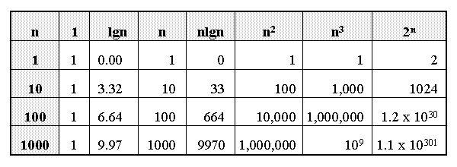
Growth of Functions

Slide 12
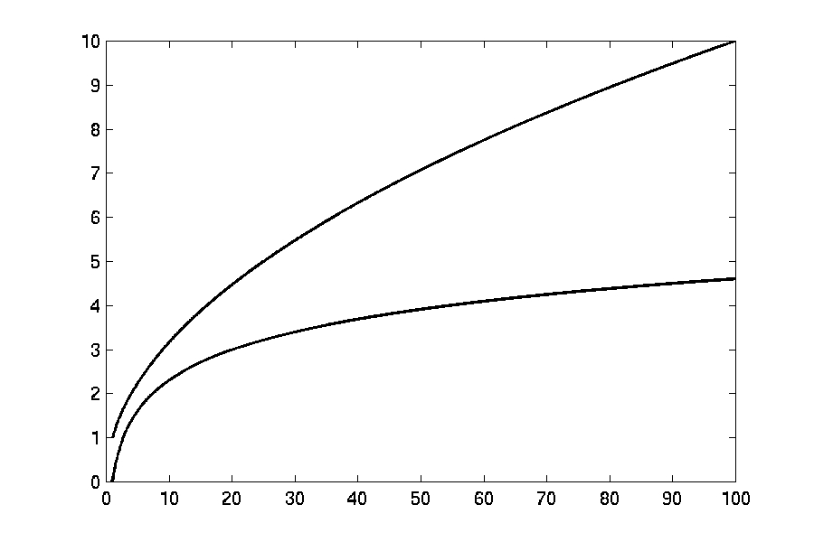

Complexity Graphs
log(n)

Slide 13
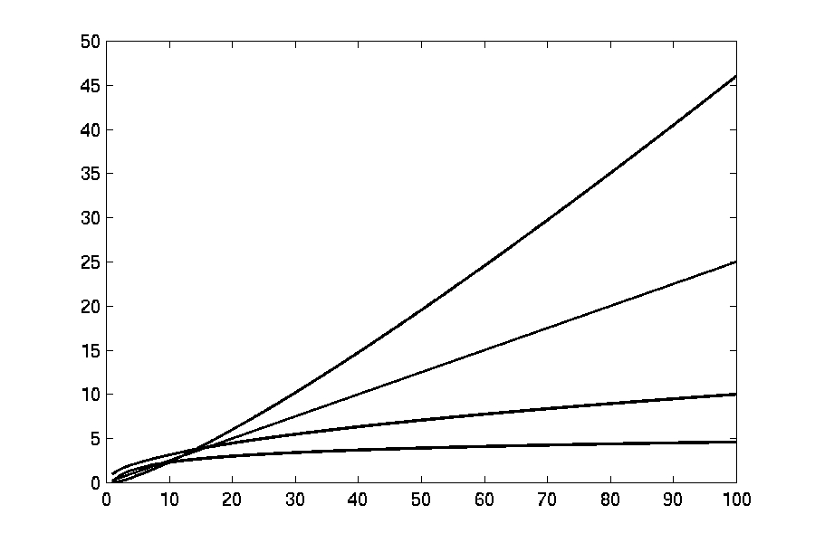

Complexity Graphs
n log(n)
n
log(n)

Slide 14
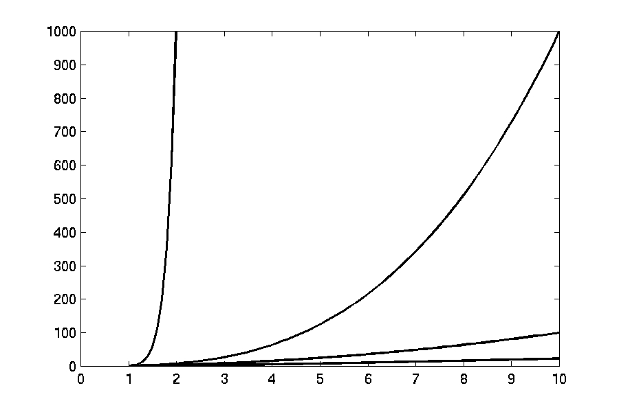
Complexity Graphs
n¹⁰
n³
n²
n log(n)

Slide 15
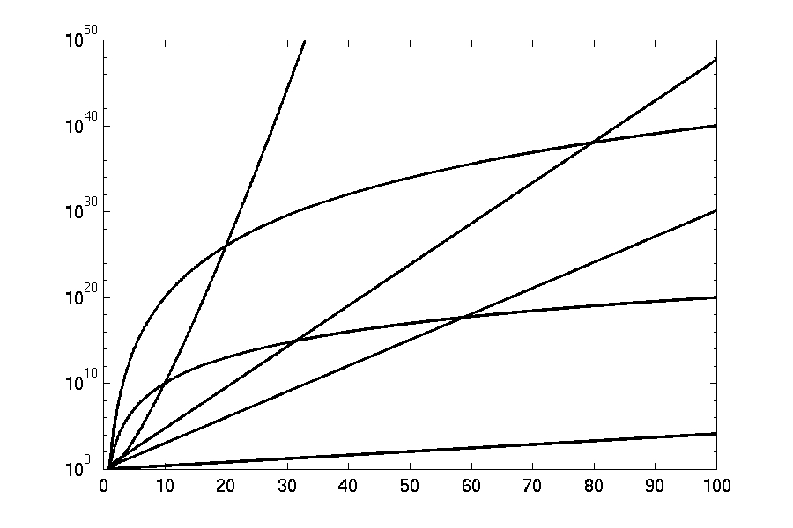
Complexity Graphs (log scale)
3^{n}
n^{n}
n²⁰
2^{n}
n¹⁰
1.1^{n}

Slide 16
How do we compare algorithms?
We need to define a number of objective measures.
(1) Compare execution times?
Not good: times are specific to a particular computer !!
(2) Count the number of statements executed?
Not good: number of statements vary with the programming language as well as the style of the individual programmer.

Slide 17
Ideal Solution
Express running time as a function of the input size n (i.e., f(n)).
Compare different functions corresponding to running times.
Such an analysis is independent of machine time, programming style, etc.

Slide 18
Example
Associate a "cost" with each statement.
Find the "total cost“ by finding the total number of times each statement is executed.
Algorithm 1 Algorithm 2
Cost Cost
arr[0] = 0; c₁ for(i=0; i<N; i++) c₂
arr[1] = 0; c₁ arr[i] = 0; c₁
arr[2] = 0; c₁
... ...
arr[N-1] = 0; c₁
----------- -------------
c₁+c₁+...+c₁ = c₁ x N (N+1) x c₂ + N x c₁ = (c₂ + c₁) x N + c₂

Slide 19
Another Example
Algorithm 3 Cost
sum = 0; c₁
for(i=0; i<N; i++) c₂
for(j=0; j<N; j++) c₂
sum += arr[i][j]; c₃
------------
c₁ + c₂ x (N+1) + c₂ x N x (N+1) + c₃ x N²

Slide 20
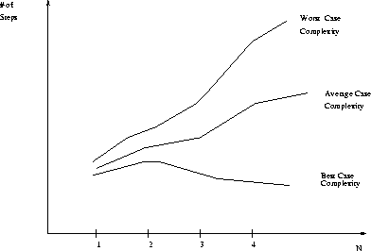
Best, Worst, and Average Case Complexity
Number of steps
Worst Case Complexity
Average Case Complexity
Best Case Complexity
N (input size)

Slide 21
Algorithm Complexity
Worst Case Complexity:
the function defined by the maximum number of steps taken on any instance of size n
Best Case Complexity:
the function defined by the minimum number of steps taken on any instance of size n
Average Case Complexity:
the function defined by the average number of steps taken on any instance of size n

Slide 22
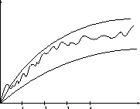
Doing the Analysis
It’s hard to estimate the running time exactly
Best case depends on the input
Average case is difficult to compute
So we usually focus on worst case analysis
Easier to compute
Usually close to the actual running time
Strategy: find a function (an equation) that, for large n, is an upper bound to the actual function (actual number of steps, memory usage, etc.)
Upper bound
Actual function
Lower bound

Slide 23
Asymptotic Growth
When trying to decide whether an algorithm is efficient we are only interested in the value of its time complexity for large values of n, because for small values of n the running time of an algorithm is very small. (For example, in the previous table, for values of n smaller than 100 the running times are much smaller than 1 second. However, for n = 1 million, the running time of the algorithm is 173 days.)

Slide 24
Motivation for Asymptotic Analysis
An exact computation of worst-case running time can be difficult
Function may have many terms:
4n² - 3n log n + 17.5 n - 43 n^{⅔} + 75
An exact computation of worst-case running time is unnecessary
Notes:
Random Access Machine (RAM) model. This model assumes a single processor. In the RAM model, instructions are executed one after the other, with no concurrent operations. This model of computation is an abstraction that allows us to compare algorithms on the basis of performance. The assumptions made in the RAM model to accomplish this are:
Each simple operation takes 1 time step.
Loops and subroutines are not simple operations.
Each memory access takes one time step, and there is no shortage of memory.

Slide 25
Asymptotic Analysis
To compare two algorithms with running times f(n) and g(n), we need a rough measure that characterizes how fast each function grows.
Hint: use rate of growth
Compare functions in the limit, that is, asymptotically!
(i.e., for large values of n)

Slide 26
Rate of Growth
Consider the example of buying a car and a packet of biscuits:
Cost: cost_of_car + cost_of_biscuit
Cost ~ cost_of_car (approximation)
The low order terms in a function are relatively insignificant for large n
n⁴ + 100n² + 10n + 50 ~ n⁴
i.e., we say that n⁴ + 100n² + 10n + 50 and n⁴ have the same rate of growth

Slide 27
Classifying functions by their Asymptotic Growth Rates
O(g(n)), Big-Oh of g of n, the Asymptotic Upper Bound
Θ(g(n)), Theta of g of n, the Asymptotic Tight Bound
Ω(g(n)), Omega of g of n, the Asymptotic Lower Bound
Notes:
asymptotically tight bound: Definition: When the asymptotic complexity of an algorithm exactly matches the theoretically proved asymptotic complexity of the corresponding problem. Informally, when an algorithm solves a problem at the theoretical minimum.

Slide 28
Asymptotic Notation
O notation: asymptotic “less than”:
→ f(n)=O(g(n)) implies: f(n) “≤” g(n)
Ω notation: asymptotic “greater than”:
→ f(n)= Ω (g(n)) implies: f(n) “≥” g(n)
Θ notation: asymptotic “equality”:
→ f(n)= Θ (g(n)) implies: f(n) “=” g(n)

Slide 29
Big-O Notation
We say f_{A}(n)=30n+8 is order n, or O (n) It is, at most, roughly proportional to n.
f_{B}(n)=n²+1 is order n², or O(n²). It is, at most, roughly proportional to n².
In general, any O(n²) function is faster- growing than any O(n) function.

Slide 30
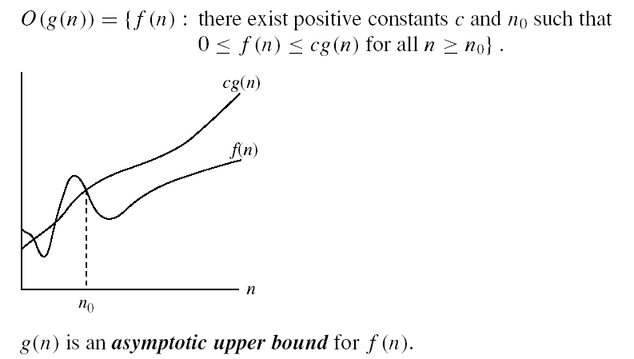
Asymptotic notations
O-notation

Slide 31
Visualizing Orders of Growth
On a graph, as you go to the right, a faster growing function eventually becomes larger...
f_{A}(n)=30n+8
Value of function →
f_{B}(n)=n²+1
Increasing n →

Slide 32
More Examples …
n⁴ + 100n² + 10n + 50 is O(n⁴)
10n³ + 2n² is O(n³)
n³ - n² is O(n³)
constants
10 is O(1)
1273 is O(1)

Slide 33
Back to Our Example
Algorithm 1 Algorithm 2
Cost Cost
arr[0] = 0; c₁ for(i=0; i<N; i++) c₂
arr[1] = 0; c₁ arr[i] = 0; c₁
arr[2] = 0; c₁
...
arr[N-1] = 0; c₁
----------- -------------
c₁+c₁+...+c₁ = c₁ x N (N+1) x c₂ + N x c₁ = (c₂ + c₁) x N + c₂
Both algorithms are of the same order: O(N)

Slide 34
Example (cont’d)
Algorithm 3 Cost
sum = 0; c₁
for(i=0; i<N; i++) c₂
for(j=0; j<N; j++) c₂
sum += arr[i][j]; c₃
------------
c₁ + c₂ x (N+1) + c₂ x N x (N+1) + c₃ x N² = O(N²)

Slide 35
Example #1: carry n books from one bookshelf to another one
How many operations?
n pick-ups, n forward moves, n drops and n reverse moves 🡪 4 n operations
4n operations = c. n = O(c. n) = O(n)
Similarly, any program that reads n inputs from the user will have minimum time complexity O(n).

Slide 36
Example #2: Locating Roll-Number record in Attendance Sheet
What is the time complexity of search?
Binary Search algorithm at work
O(log n)
Sequential search?
O(n)

Slide 37
Example #3: Teacher of CSE 221 gives gifts to first 10 students
There are n students in the queue.
Teacher brings one gift at a time.
Time complexity = O(c. 10) = O(1)
Teacher will take exactly same time irrespective of the line length.

Slide 38
Loops with Break
for (j = 0; j < n; ++j)
{
// 3 atomics
if (condition) break;
}
Upper bound = O(4n) = O(n)
Lower bound = Ω(4) = Ω(1)
Complexity = O(n)

Slide 39
Sequential Search
Given an unsorted vector/list a[ ], find the location of element X.
for (i = 0; i < n; i++) {
if (a[i] == X) return true;
}
return false;
Input size: n = array size()
Complexity = O(n)

Slide 40
If-then-else Statement
if(condition)
i = 0;
else
for ( j = 0; j < n; j++)
a[j] = j;
Complexity = ??
= O(1) + max ( O(1), O(N))
= O(1) + O(N)
= O(N)

Slide 41
Consecutive Statements
for (j = 0; j < n; ++j) {
// 3 atomics
}
for (j = 0; j < n; ++j) {
// 5 atomics
}
Add the complexity of consecutive statements
Complexity = O(3n + 5n) = O(n)

Slide 42
Nested Loop Statements
Analyze such statements inside out
for (j = 0; j < n; ++j) {
// 2 atomics
for (k = 0; k < n; ++k) {
// 3 atomics
}
}
Complexity = (2 + 3n)n = O(n^2)

Slide 43
Example
Code:
a = b;
Complexity:
O(1)
Notes:
constant

Slide 44
Example
Code:
sum = 0;
for (i=1; i <=n; i++)
sum += n;
Complexity:
O(n)
Notes:
linear

Slide 45
Example
Code:
sum1 = 0;
for (i=1; i<=n; i++)
for (j=1; j<=n; j++)
sum1++;
Complexity:
O(n^2)
Notes:
Obviousy n squared

Slide 46
Example
Code:
sum2 = 0;
for (i=1; i<=n; i++)
for (j=1; j<=i; j++)
sum2++;
Complexity:
O(n^2)

Slide 47
Example
Code:
sum = 0;
for (j=1; j<=n; j++)
for (i=1; i<=j; i++)
sum++;
for (k=0; k<n; k++)
A[k] = k;
Complexity:
O(n^2)
Notes:
N squared == 1 + 2 + … + N

Slide 48
Example
Code:
sum1 = 0;
for (k=1; k<=n; k*=2)
for (j=1; j<=n; j++)
sum1++;
Complexity:
O(nlogn)
Notes:
outer loop O(lg N), inner loop (N) == O (N lg N) by product rule

Slide 49
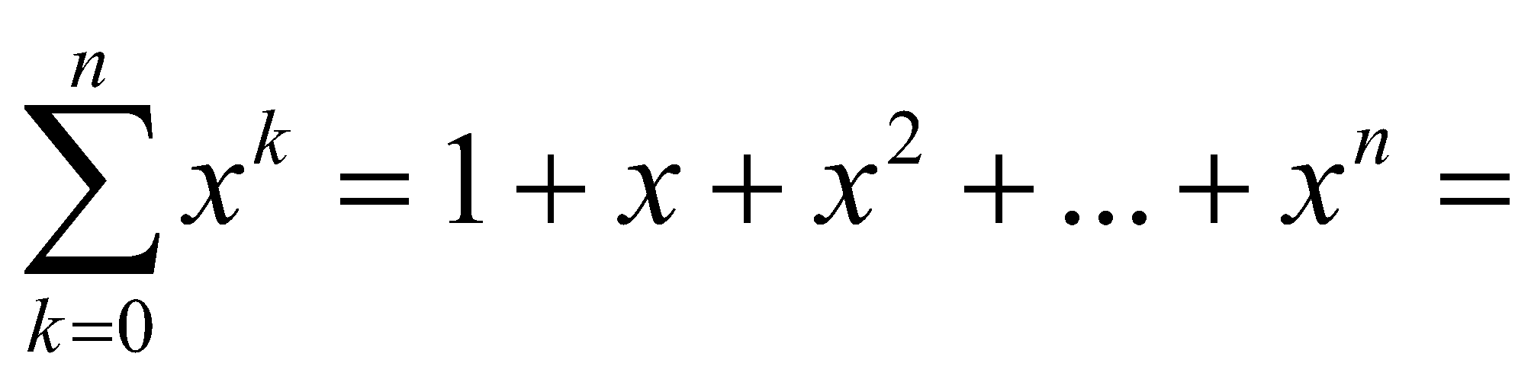
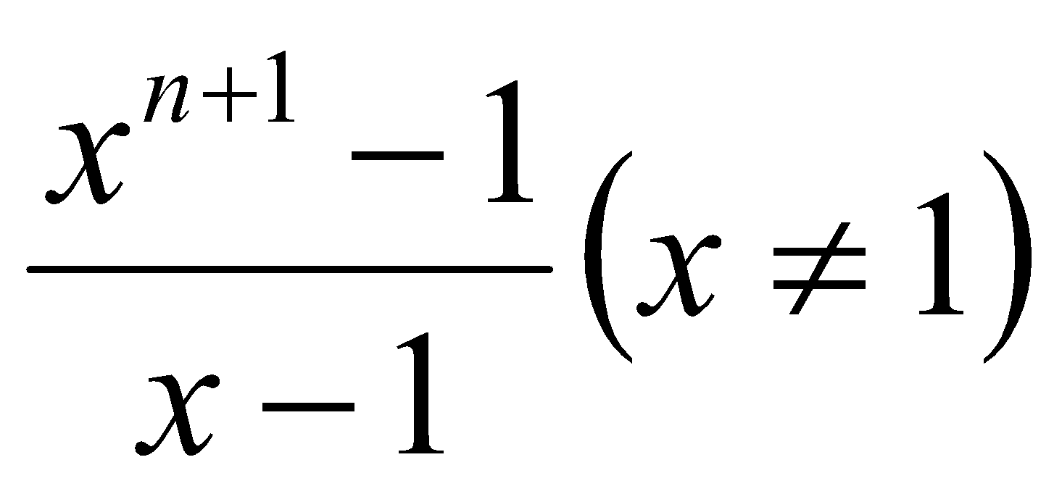
Example
Code:
sum2 = 0;
for (k=1; k<=n; k*=2)
for (j=1; j<=k; j++)
sum2++;
Complexity:
O(n)
Notes:
outer O (lg N) inner = sum of powers of 2 which is linear since
The sum of powers of 2 dividing into N is 2N so its O (N lg N) by product rule

Slide 50
Classifying functions by their Asymptotic Growth Rates
O(g(n)), Big-Oh of g of n, the Asymptotic Upper Bound
Θ(g(n)), Theta of g of n, the Asymptotic Tight Bound
Ω(g(n)), Omega of g of n, the Asymptotic Lower Bound
Notes:
asymptotically tight bound: Definition: When the asymptotic complexity of an algorithm exactly matches the theoretically proved asymptotic complexity of the corresponding problem. Informally, when an algorithm solves a problem at the theoretical minimum.

Slide 51
Asymptotic notations
O-notation

Slide 52
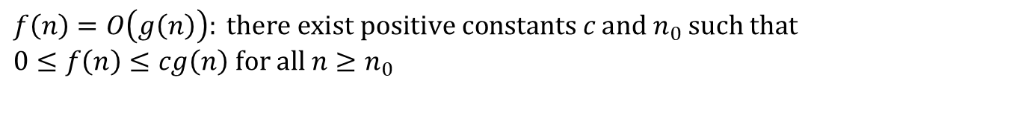
Big-O
What does it mean?
If f(n) = O(n²), then:
f(n) can be larger than n² sometimes, but…
We can choose some constant c and some value n₀ such that for every value of n larger than n₀ : f(n) < cn²
That is, for values larger than n₀, f(n) is never more than a constant multiplier greater than n²
Or, in other words, f(n) does not grow more than a constant factor faster than n².

Slide 53
Examples
2n² = O(n³):
n² = O(n²):
1000n²+1000n = O(n²):
n = O(n²):
2n² ≤ cn³ ⇒ 2 ≤ cn ⇒ c = 1 and n₀= 2
n² ≤ cn² ⇒ c ≥ 1 ⇒ c = 1 and n₀= 1
1000n²+1000n ≤ 1000n²+ n² =1001n²⇒ c=1001 and n₀ = 1000
n ≤ cn² ⇒ cn ≥ 1 ⇒ c = 1 and n₀= 1

Slide 54
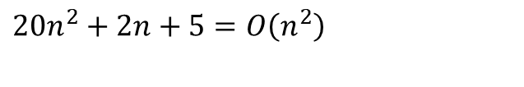
More Big-O
Prove that:
Let c = 21 and n₀ = 4
21n² > 20n² + 2n + 5 for all n > 4
n² > 2n + 5 for all n > 4
TRUE

Slide 55

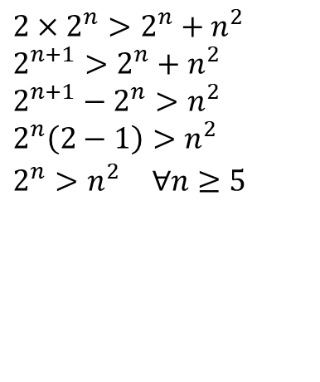
Examples
Show that
Let c = 2 and n₀ = 5

Slide 56
More Examples
Show that 30n+8 is O(n).
Show ∃c,n₀: 30n+8 ≤ cn, ∀n>n₀ .
Let c=31, n₀=8. Assume n>n₀=8. Then cn = 31n = 30n + n > 30n+8, so 30n+8 < cn.

Slide 57
Big-O example, graphically
Note 30n+8 isn’t less than n anywhere (n>0).
It isn’t even less than 31n everywhere.
But it is less than 31n everywhere to the right of n=8.
cn = 31n
30n+8
Value of function →
30n+8 ∈O(n)
n
n>n₀=8 →
Increasing n →

Slide 58
No Uniqueness
There is no unique set of values for n₀ and c in proving the asymptotic bounds
Prove that 100n + 5 = O(n²)
100n + 5 ≤ 100n + n = 101n ≤ 101n²
for all n ≥ 5
n₀ = 5 and c = 101 is a solution
100n + 5 ≤ 100n + 5n = 105n ≤ 105n² for all n ≥ 1
n₀ = 1 and c = 105 is also a solution
Must find SOME constants c and n₀ that satisfy the asymptotic notation relation

Slide 59
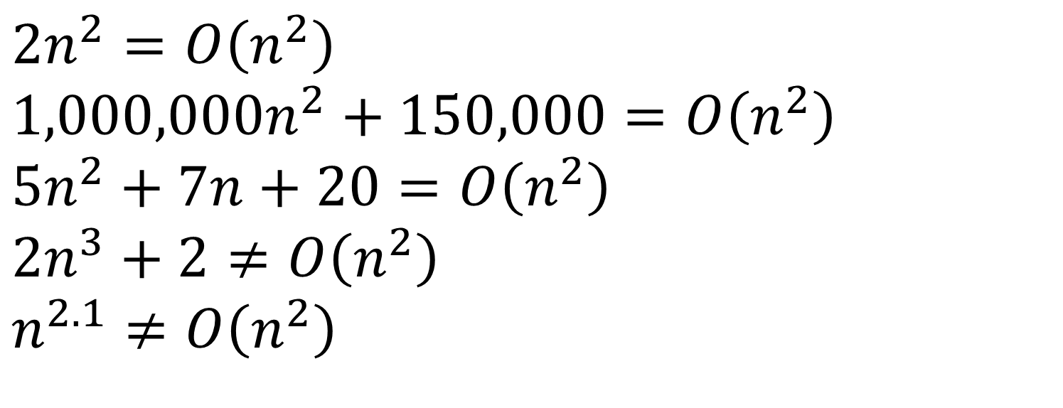
Big-O

Slide 60
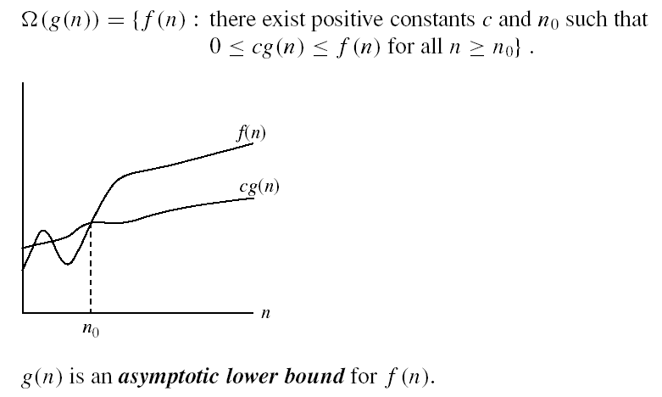
Asymptotic notations
Ω - notation
Ω(g(n)) is the set of functions with larger or same order of growth as g(n)

Slide 61
Examples
5n² = Ω(n)
100n + 5 ≠ Ω(n²)
2n = Ω(n), n³ = Ω(n²), n = Ω(logn)
∃ c, n₀ such that: 0 ≤ cn ≤ 5n²
⇒ cn ≤ 5n²
⇒ c = 5 and n₀ = 1
∃ c, n₀ such that: 0 ≤ cn² ≤ 100n + 5
100n + 5 ≤ 100n + 5n (∀ n ≥ 1) = 105n
cn² ≤ 105n
⇒ n(cn – 105) ≤ 0
Since n is positive ⇒ cn – 105 ≤ 0
⇒ n ≤ 105/c
⇒ contradiction: n cannot be smaller than a constant

Slide 62

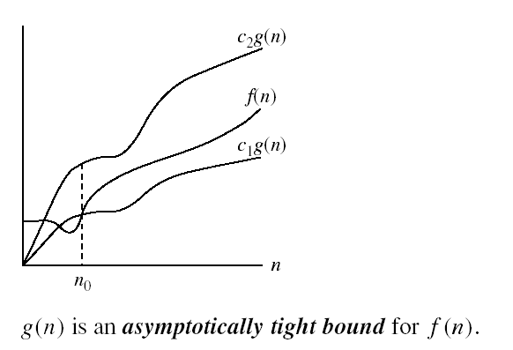
Asymptotic notations (cont.)
Θ-notation
Θ(g(n)) is the set of functions with the same order of growth as g(n)

Slide 63
Examples
n²/2 –n/2 = Θ(n²)
½ n² - ½ n ≤ ½ n² ∀n ≥ 0 ⇒ c₂= ½
½ n² - ½ n ≥ ½ n² - ½ n * ½ n ( ∀n ≥ 2 ) = ¼ n²
⇒ c₁= ¼
n ≠ Θ(n²):
c₁ n² ≤ n ≤ c₂ n²
⇒ only holds for: n ≤ 1/c₁

Slide 64
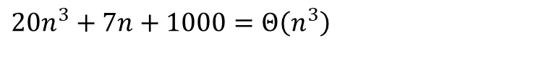
Examples
Prove that:
Let c₁ = 21 and n₀ = 10
21n³ > 20n³ + 7n + 1000 for all n > 10
n³ > 7n + 1000 for all n > 10
TRUE, but we also need…
Let c₂ = 20 and n₀ = 1
20n³ < 20n³ + 7n + 1000 for all n ≥ 1
TRUE

Slide 65
Relations Between Different Sets
Subset relations between order-of-growth sets.
O( f )
R→R
Ω( f )
• f
Θ( f )

Slide 66
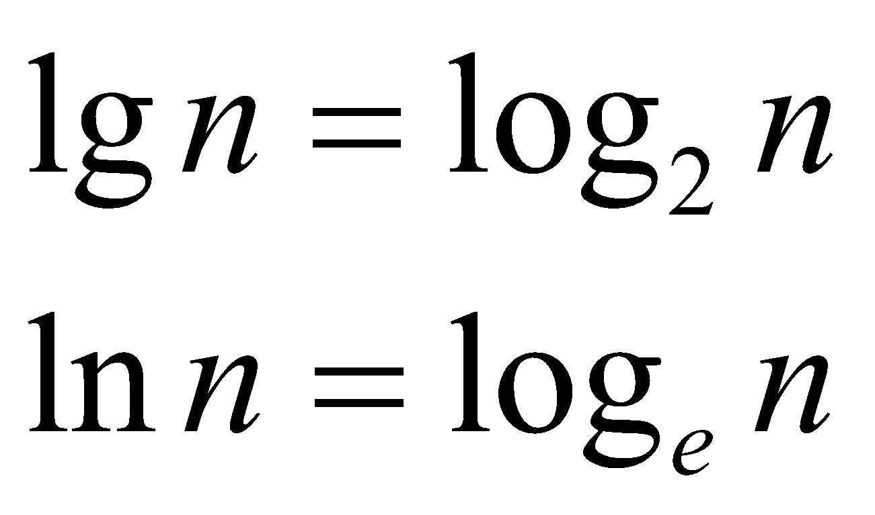
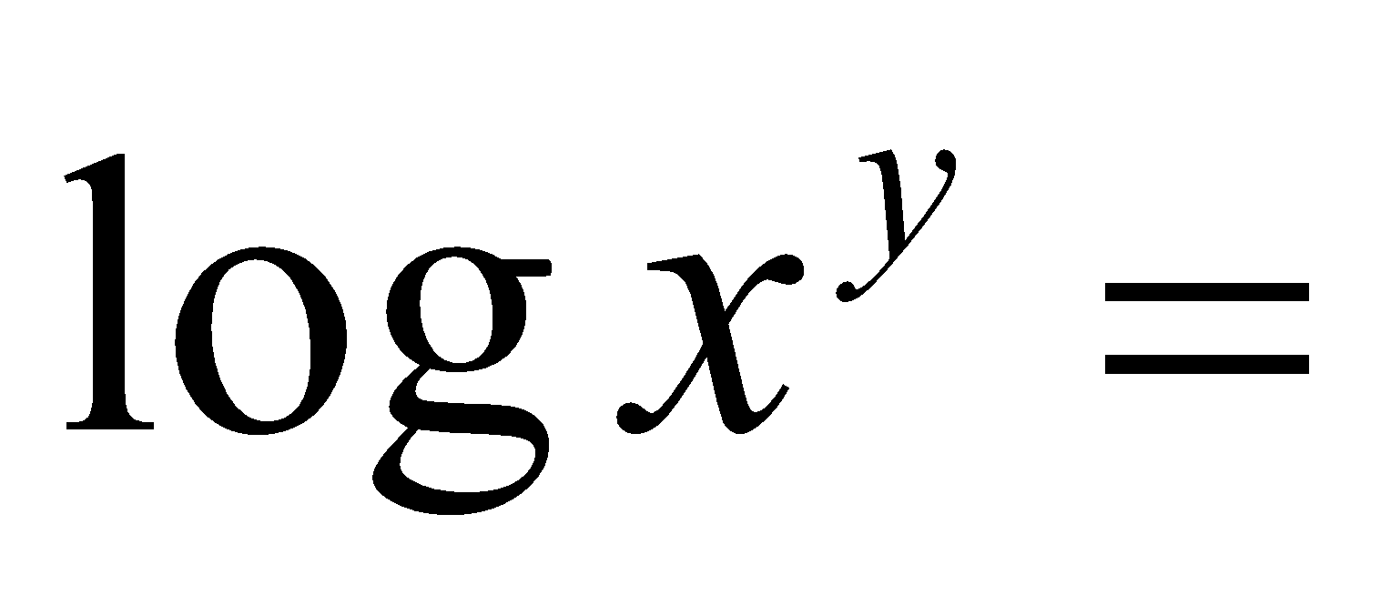
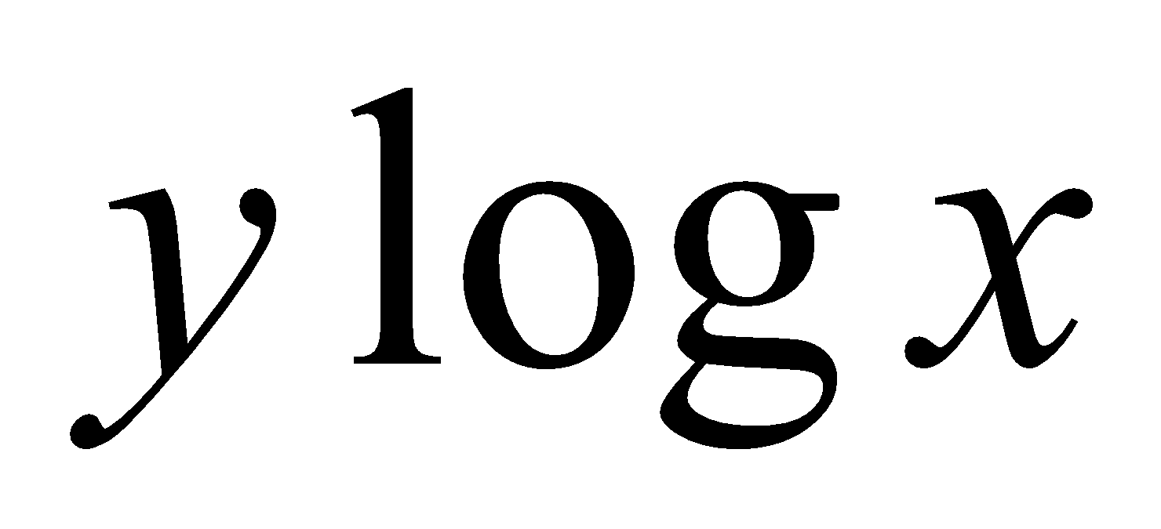
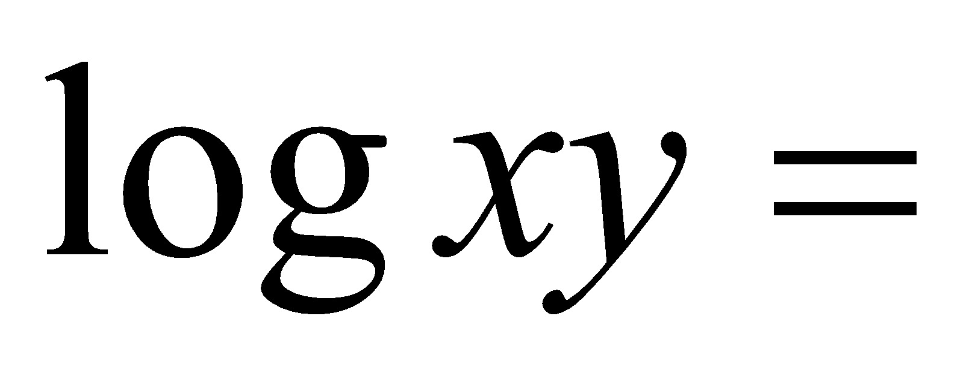
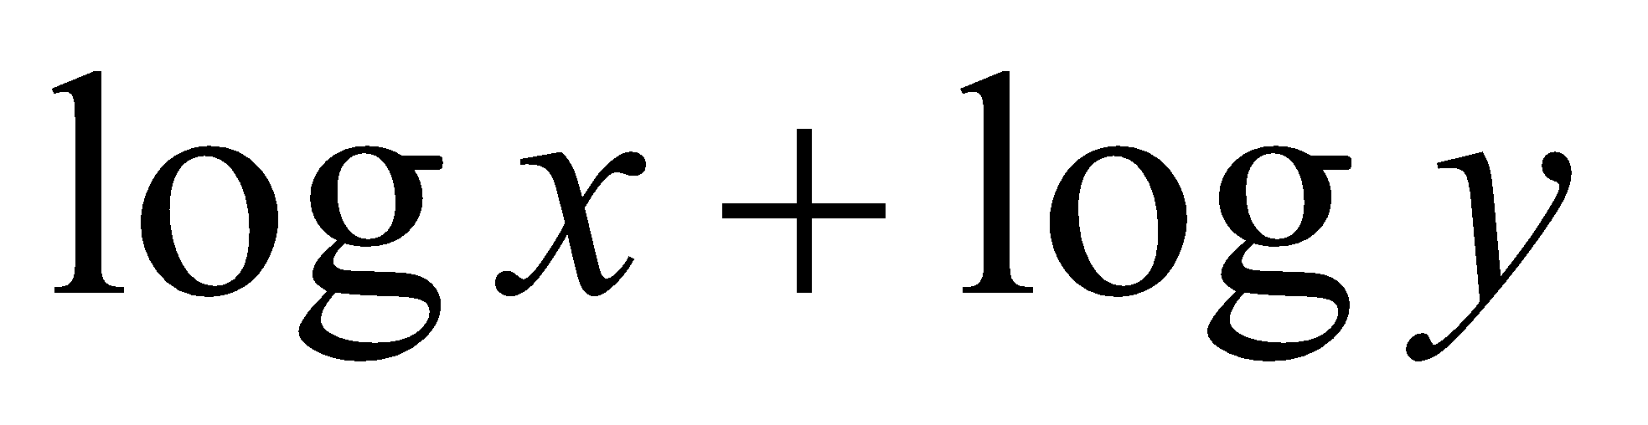
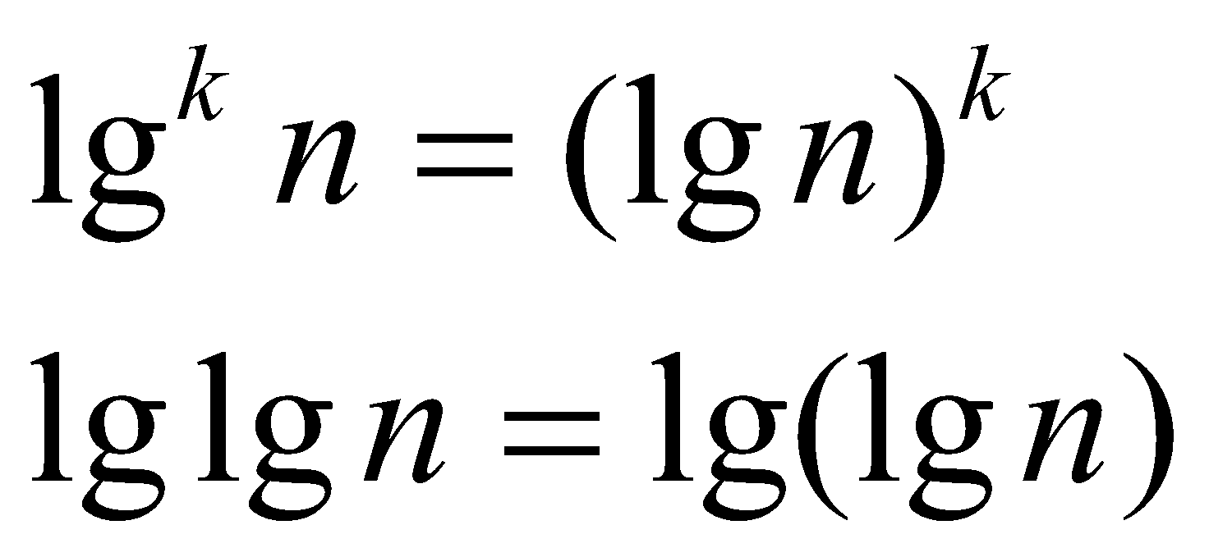
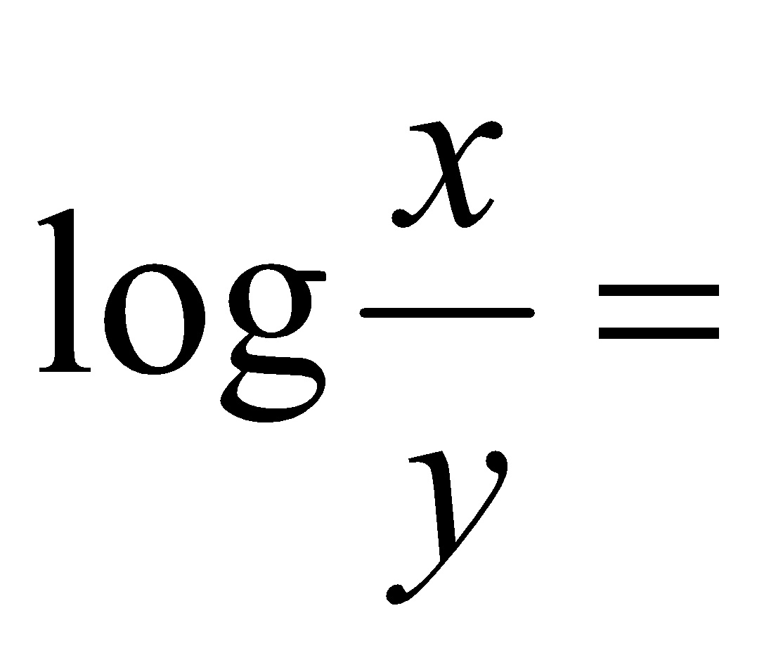
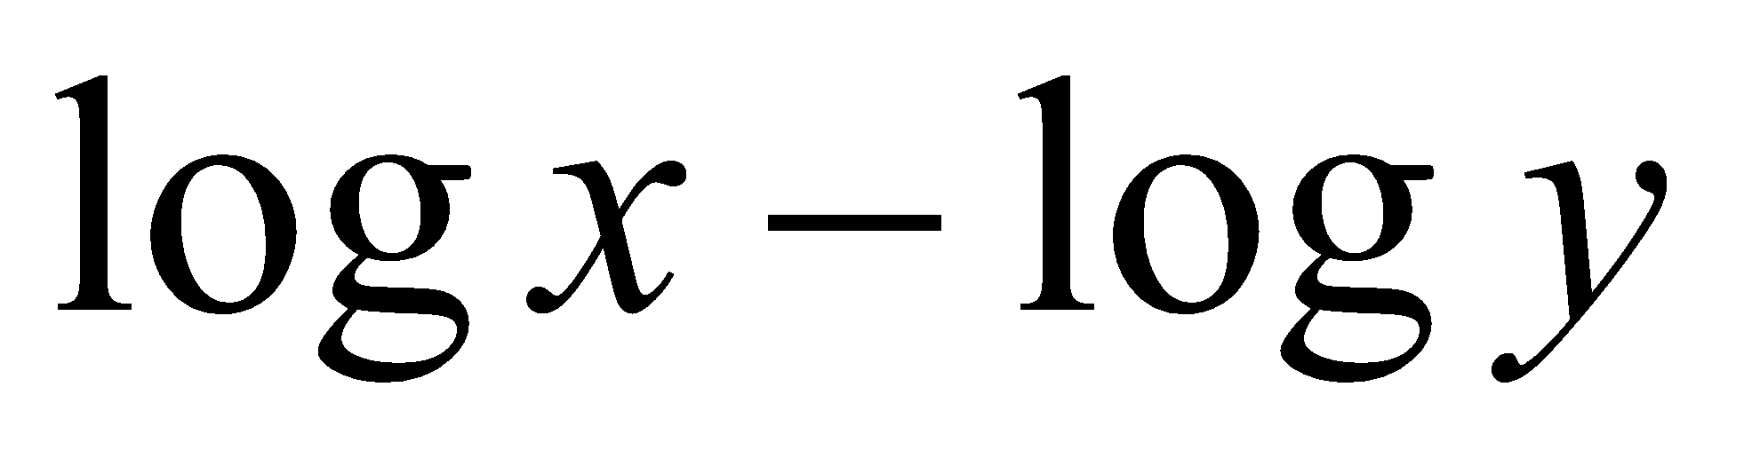
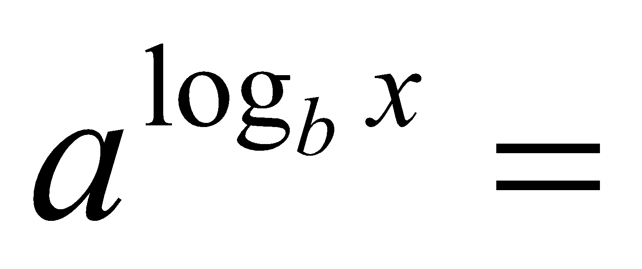
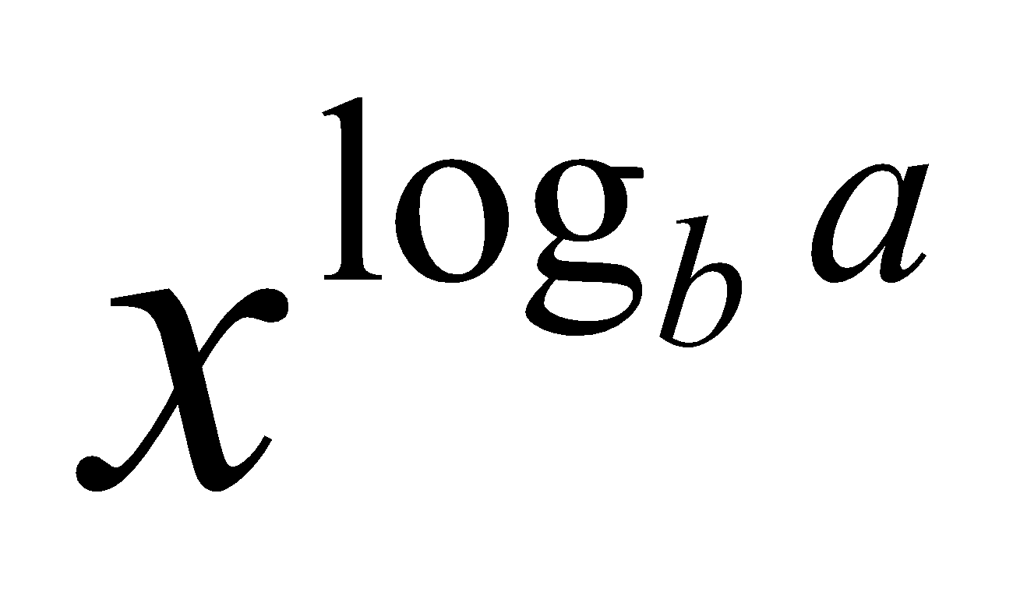
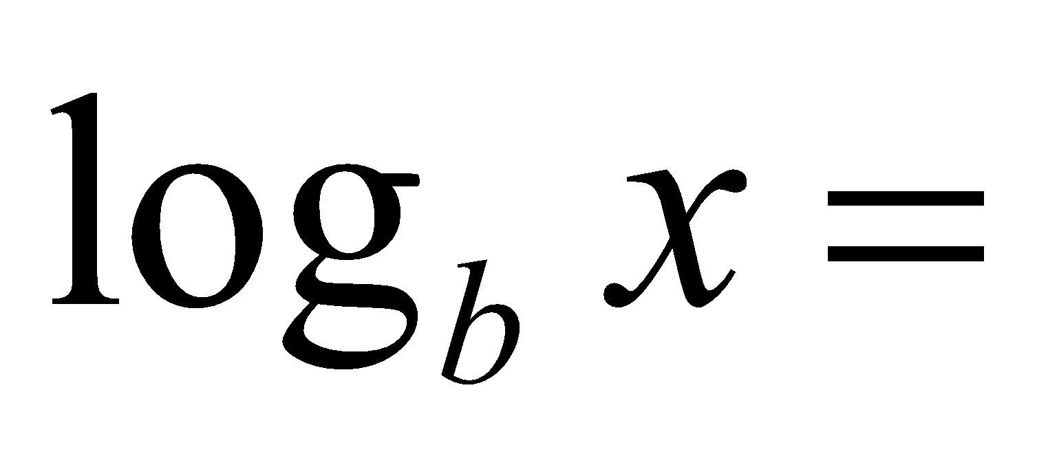
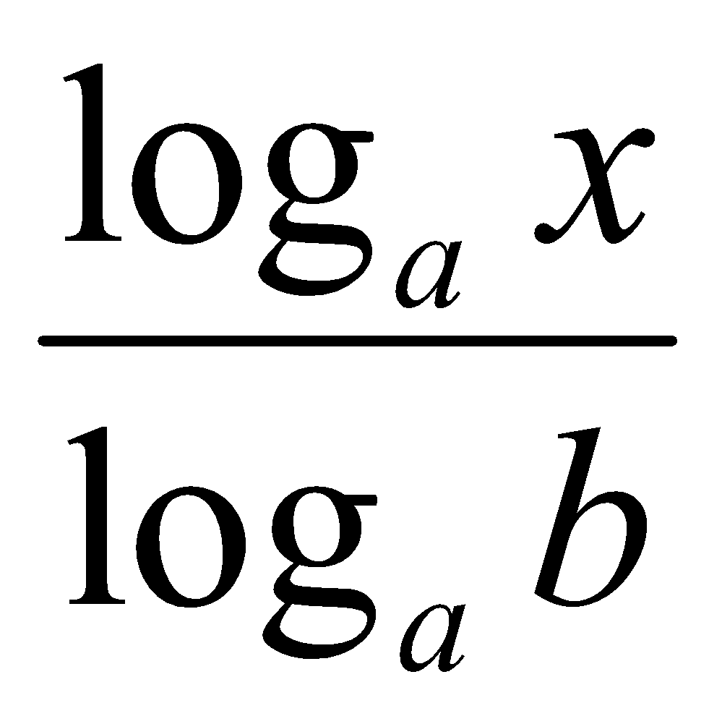
Logarithms and properties
In algorithm analysis we often use the notation “log n” without specifying the base
Binary logarithm
Natural logarithm

Slide 67
Simplifying Assumptions
1. If f(n) = O(g(n)) and g(n) = O(h(n)), then f(n) = O(h(n))
2. If f(n) = O(kg(n)) for any k > 0, then f(n) = O(g(n))
3. If f₁(n) = O(g₁(n)) and f₂(n) = O(g₂(n)),
then f₁(n) + f₂(n) = O(max (g₁(n), g₂(n)))
4. If f₁(n) = O(g₁(n)) and f₂(n) = O(g₂(n)),
then f₁(n) * f₂(n) = O(g₁(n) * g₂(n))

Slide 68
Some Simplified Rules
O(1) = c , where c is a constant
O(n) = c*n = cn , where c is constant and n is variable
c₁*O(1) = c₁*c = c₂ = O(1) , where c,c₁,c₂ are constants
O(1) + O(1) + O(1) = 3*O(1) = O(1)
5*O(1) = O(1)
n*O(1) = n*c = cn = O(n) , where c is constant and n is variable
O(m) + O(n) ≠ O(m+n)
O(m) * O(n) = c₁mc₂n = (c₁*c₂)(mn) = (c₂)(mn) = O(mn)
O(m)*O(n)*O(p)*O(q) = O(m(n(p(q)))) = O(mnpq)
Example nested for loops
O(an² + bn + c) = O(n²) where a, b , c are constants

Slide 69
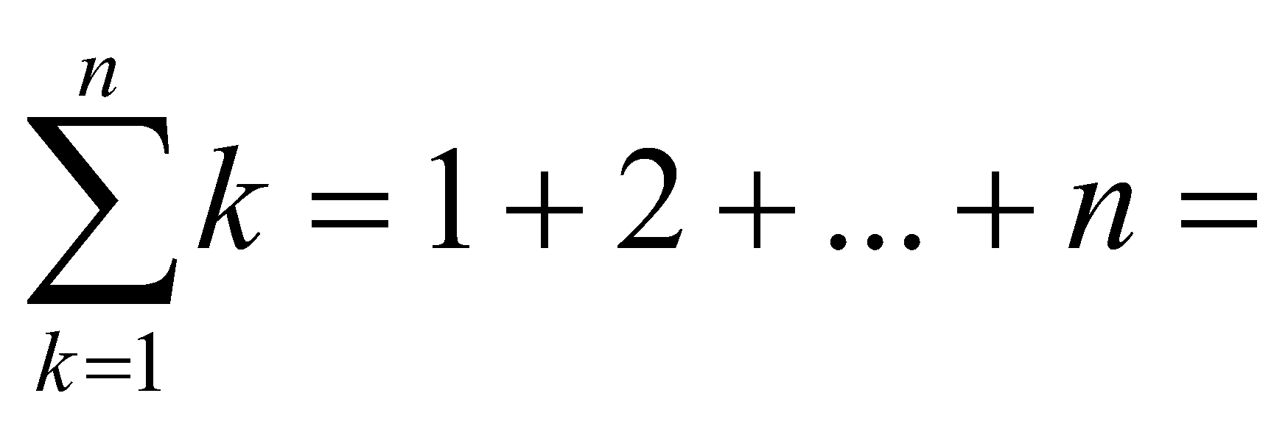
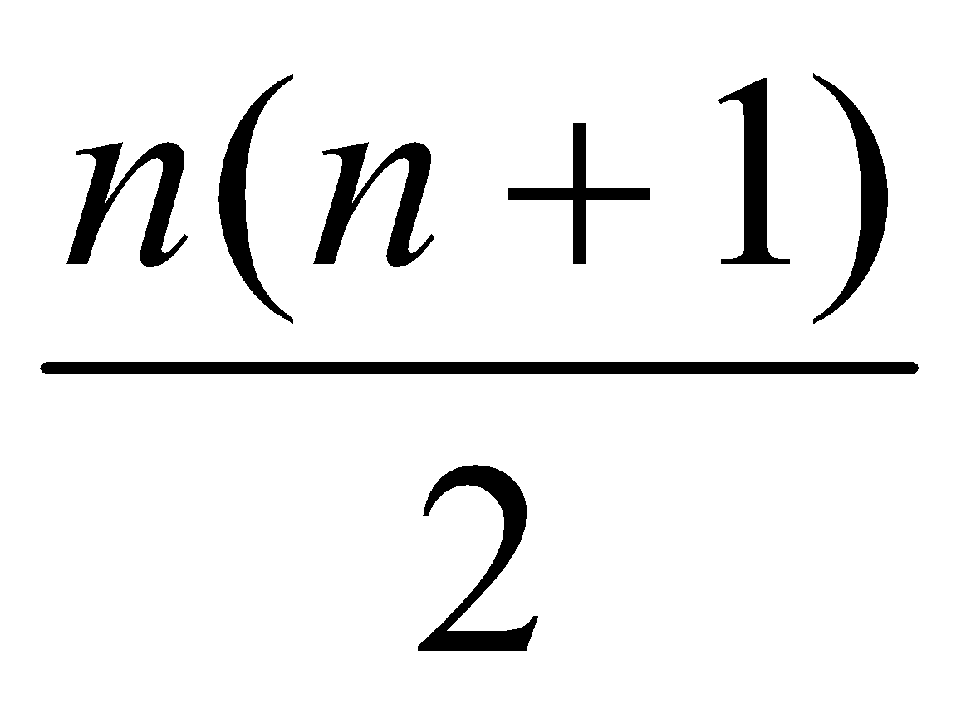
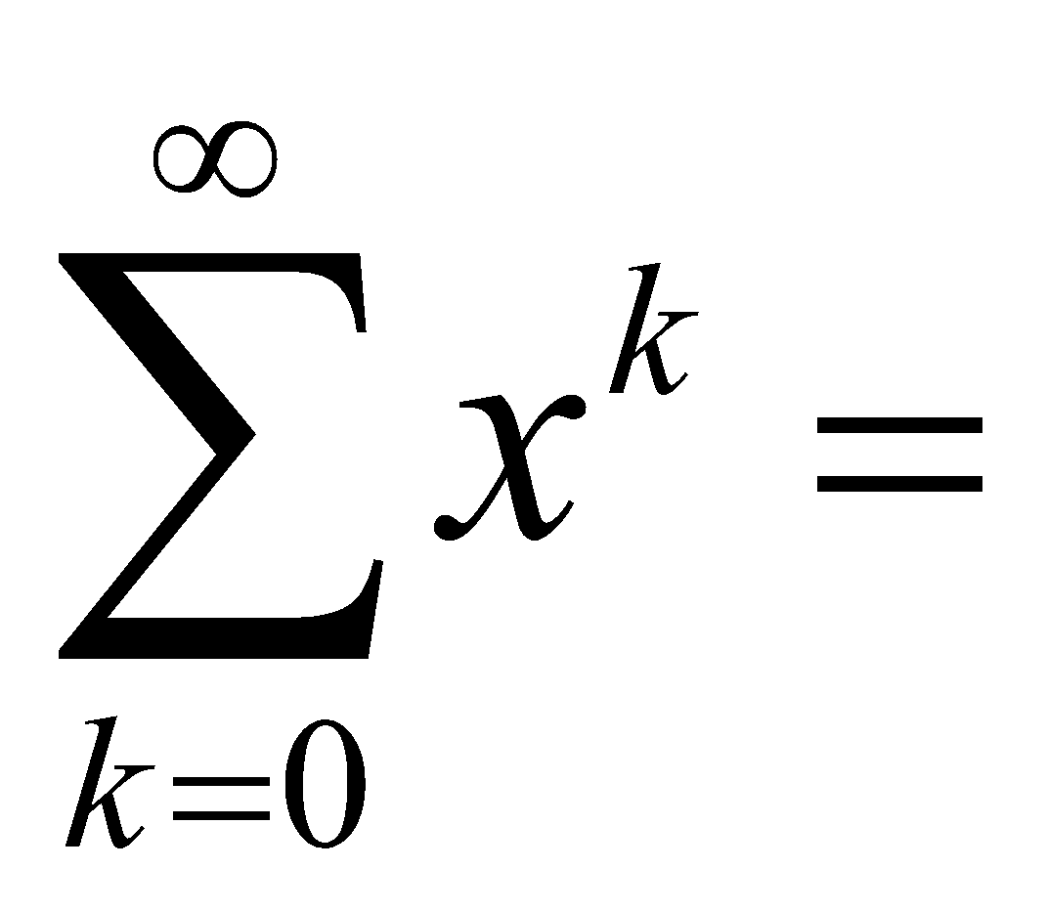
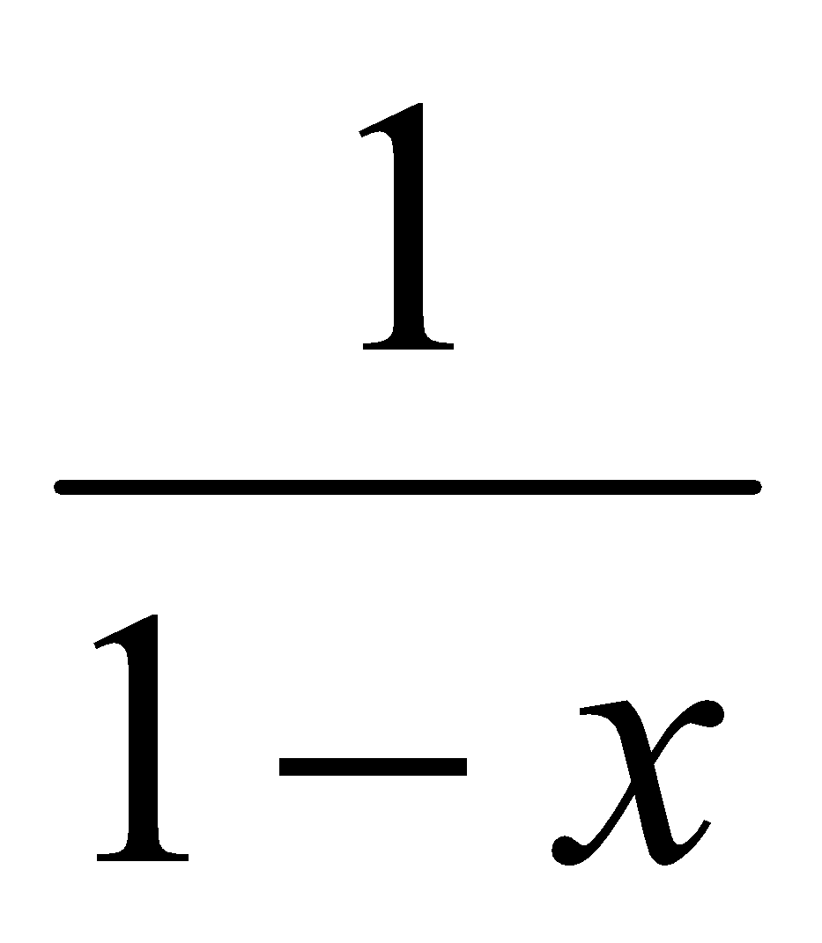
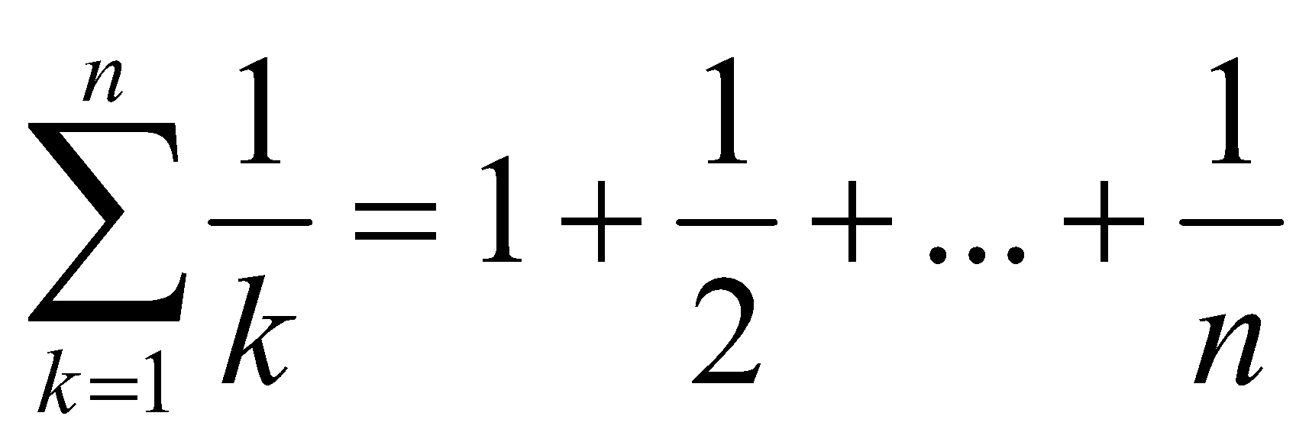
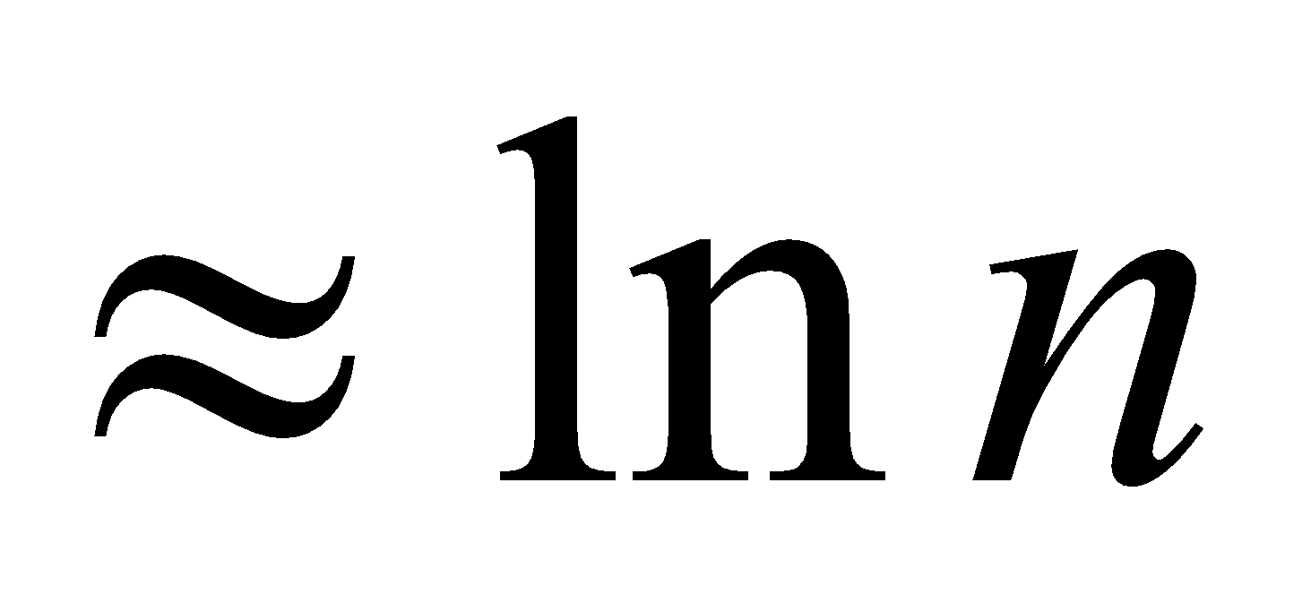
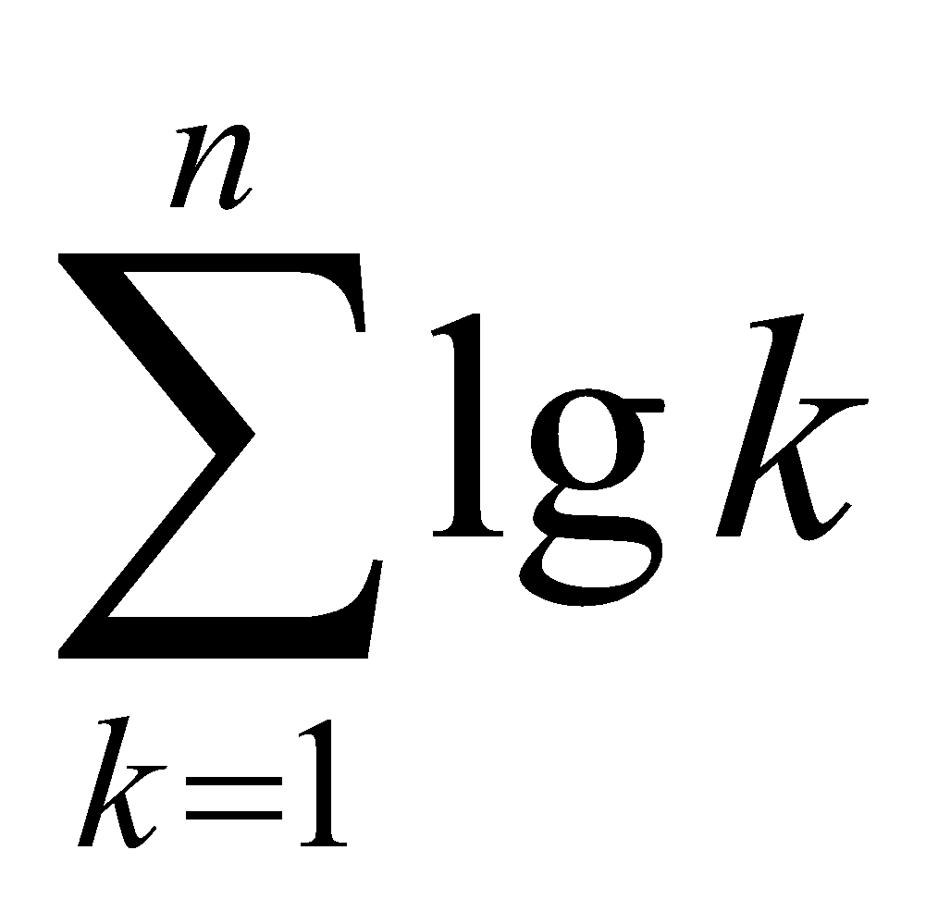
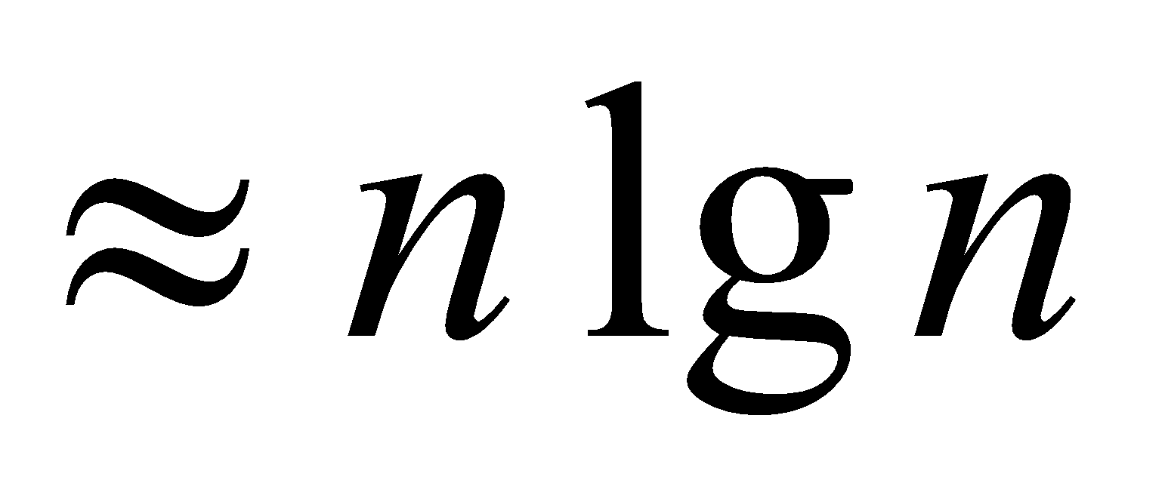
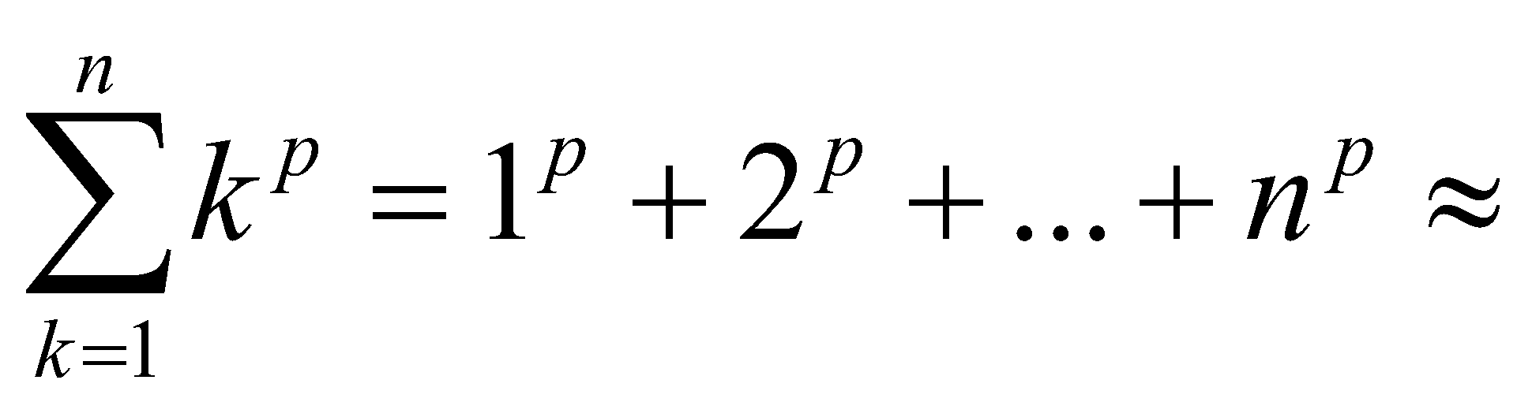
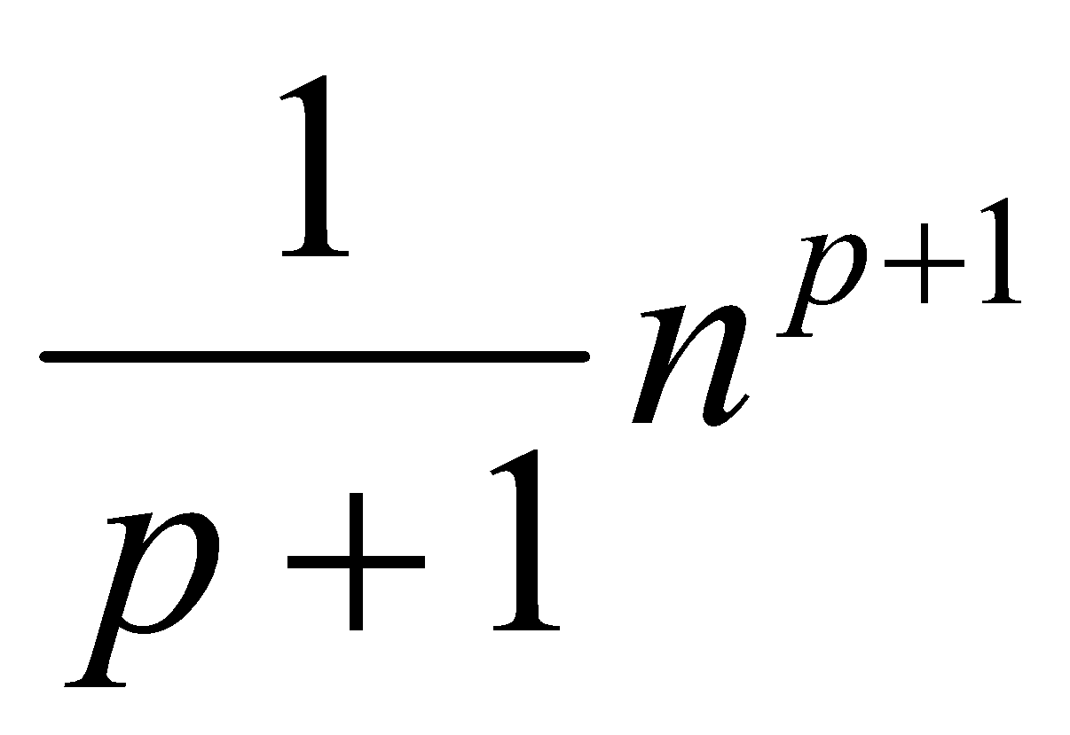
Common Summations
Arithmetic series:
Geometric series:
Special case: |x| < 1:
Harmonic series:
Other important formulas:
‹#›

Slide 70
More Examples
For each of the following pairs of functions, either f(n) is O(g(n)), f(n) is Ω(g(n)), or f(n) = Θ(g(n)). Determine which relationship is correct.
f(n) = log n²; g(n) = log n + 5
f(n) = n; g(n) = log n²
f(n) = log log n; g(n) = log n
f(n) = n; g(n) = log² n
f(n) = Θ (g(n))
f(n) = Ω(g(n))
f(n) = O(g(n))
f(n) = Ω(g(n))

Slide 71
More Examples
For each of the following pairs of functions, either f(n) is O(g(n)), f(n) is Ω(g(n)), or f(n) = Θ(g(n)). Determine which relationship is correct.
f(n) = n log n + n; g(n) = log n
f(n) = 10; g(n) = log 10
f(n) = 2^{n}; g(n) = 10n²
f(n) = 2^{n}; g(n) = 3^{n}
f(n) = Ω(g(n))
f(n) = Θ(g(n))
f(n) = Ω(g(n))
f(n) = O(g(n))

Slide 72
Asymptotic Notations - Examples
O notation
2n² vs. n³
n² vs. n²
n³ vs. nlogn
2n² = O(n³)
n² = O(n²)
n³ ≠ O(nlogn)

Slide 73
Asymptotic Notations - Examples
Θ notation
n²/2 – n/2
(6n³ + 1)lgn/(n + 1)
n vs. n²
= Θ(n²)
= Θ(n²lgn)
n ≠ Θ(n²)

Slide 74
Asymptotic Notations - Examples
Ω notation
n³ vs. n²
n vs. logn
n vs. n²
n³ = Ω(n²)
n = Ω(logn)
n ≠ Ω(n²)

Slide 75
Summary
Time complexity is a measure of algorithm efficiency
Efficient algorithm plays the major role in determining the running time.
Q: Is it possible to determine running time based on algorithm’s time complexity alone?
Minor tweaks in the code can cut down the running time by a factor too.
Other items like CPU speed, memory speed, device I/O speed can help as well.
For certain problems, it is possible to allocate additional space & improve time complexity.

